Slide 1
GEOL 599
Applied Machine Learning for Geoscience Data
Lecture 2
Linear regression and KNN
Test/train split
Handling missing data

Slide 2
Class logistics
Turn in homework (Rmarkdown knitted, completed jupyter notebook, python code + figures and answers to Qs)
Notebooks now on Blackboard
Git Repo
Remaining issues from class 1
  Some code not working on some windows machines

Slide 3
Discussion Question
On a residential, two-way street with no sidewalks, on what side of the street should you walk?
A. Right
B. Left
C. Either
D. You aren’t allowed to walk on those streets

Slide 4
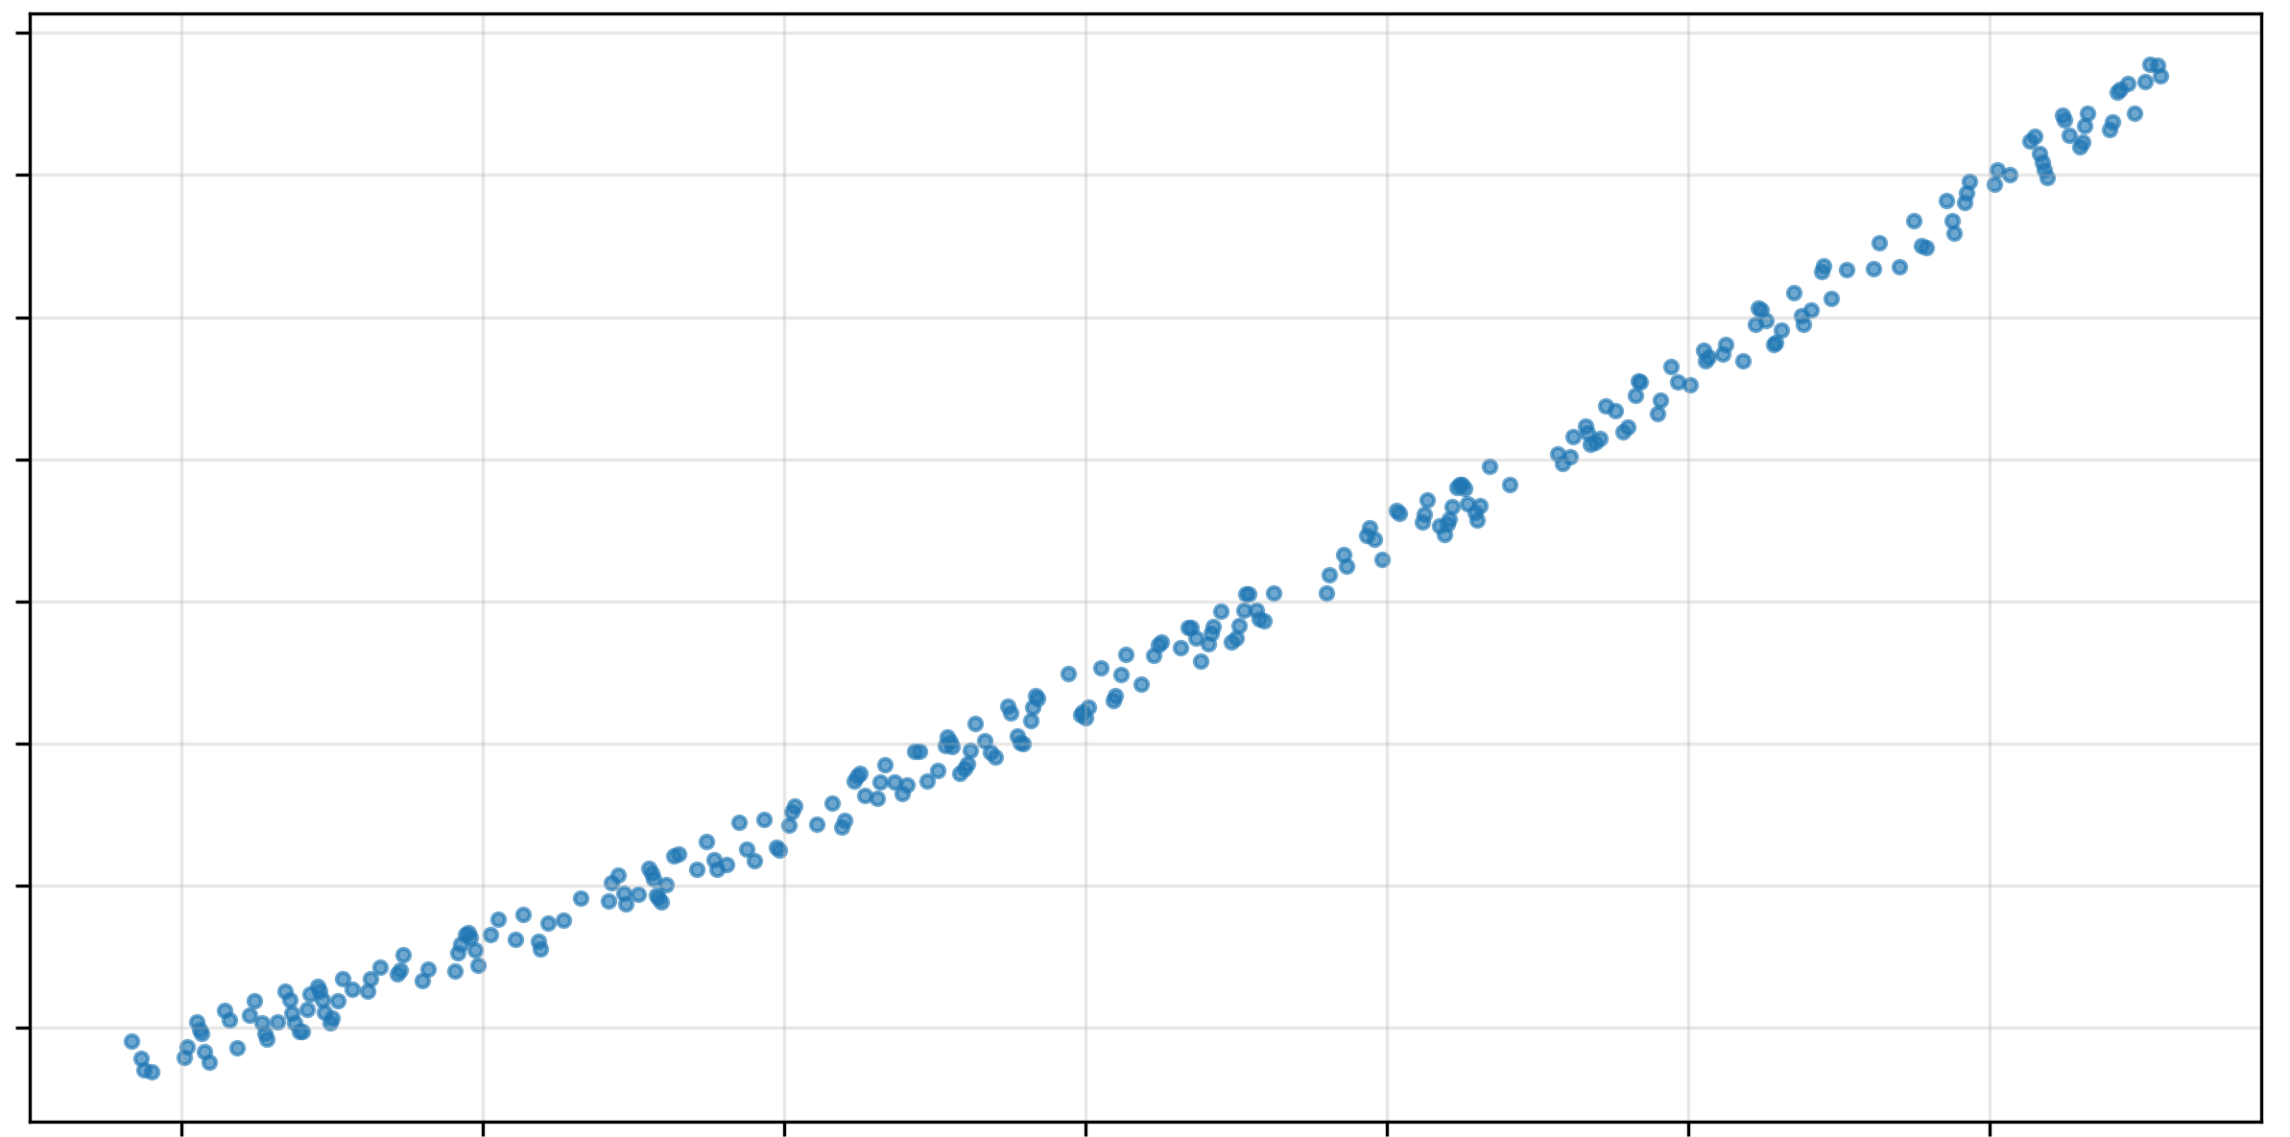
How to fit a curve

Slide 5
Defining the problem
Question | Answer
What is the prediction target? | Soil organic carbon, flood occurrence, daily streamflow, land-cover class
What is the spatial resolution? | 10 m Sentinel-2 pixels, 1 km grid cells, watershed averages
What is the temporal resolution? | Hourly, daily, monthly, annual, event-based
What is the intended use? | Forecasting, mapping, interpolation, risk ranking, classification
What is the deployment domain? | Same region, new region, future period, global map, new sensor
What kind of error matters most? | Large flood misses, false landslide alarms, average streamflow error

Slide 6
Understand your data!
Anscombe's quartet
  approximately the same linear regression line
  nearly identical means, standard deviations, and correlations
  graphically very different
  this illustrates the pitfalls of relying solely on a fitted model to understand the relationship between variables.

Slide 7
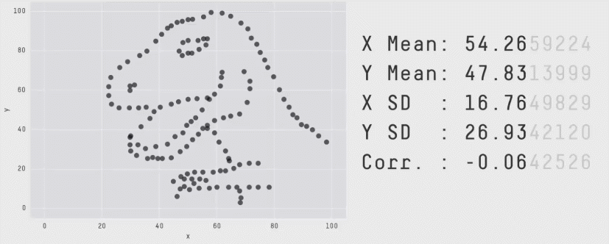
Fun data relations

Slide 8
Fit these data
y
x

Slide 9
Linear Regression
Notes:
On board

Slide 10
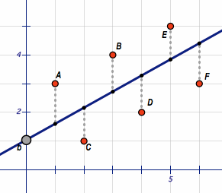
Ordinary least squares
The model is built by minimizing a “cost” function.
  Cost or loss is the difference between the predicted values and the actual values of the target, i.e., residuals.
In linear regression, the sum of squared residuals
Notes:
What constitutes cost in this case (same as “loss function” in this case)?

Slide 11
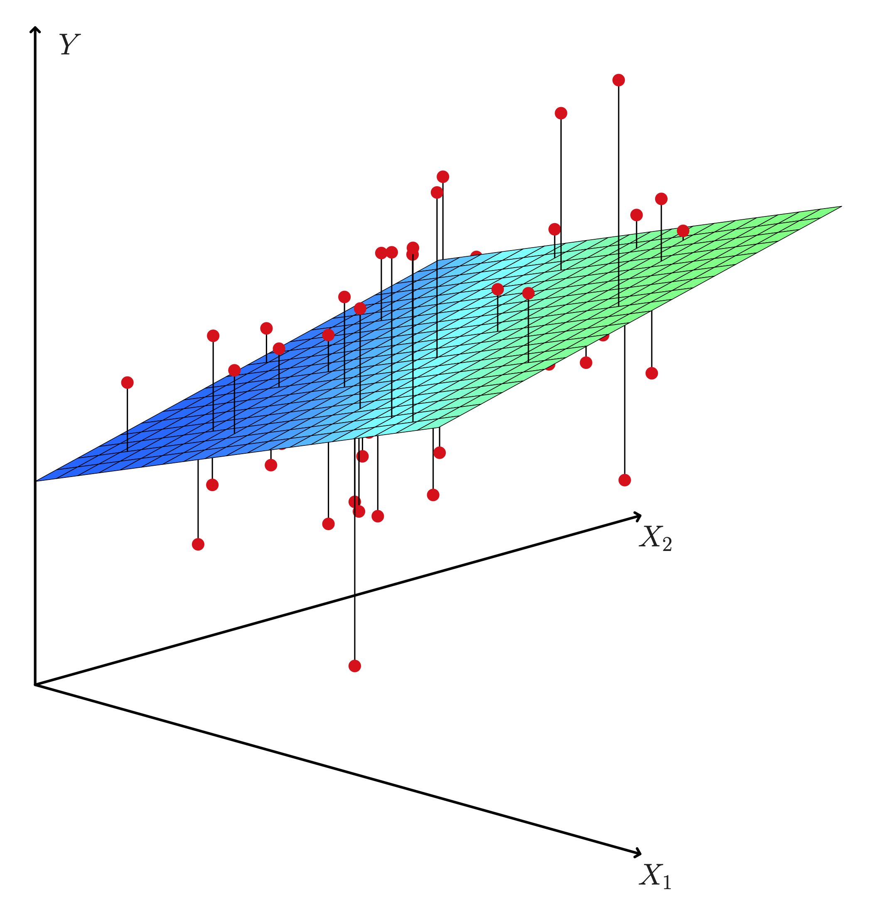
Multiple regression
Simple linear regression has 2 variable
  1 target, 1 feature
Multiple linear regression has >2 variables
  1 target, many features
Estimates change in y (target) for a 1 unit increase in x_{n} holding all other features constant

Slide 12
k-nearest neighbor (KNN)
If K =1 also known as NN (nearest neighbor)
  Determine the label of the closest point to the unlabeled point assign the same label to the unknown point.
If K> 1
  Take the majority vote of the closest K labeled examples
Based on feature similarity, i.e. “distance”
“Close” is defined by a feature, or a set of features. It can be actual physical distance, or it can be measurements of other features (e.g., sea surface temperature).

Slide 13
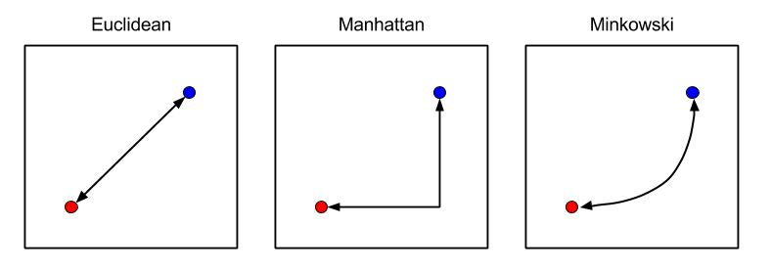
A note on different “distance” metrics for KNN
Manhattan
  Good for high dimensional data (curse of dimensionality)
Euclidean
Minkowski

Slide 14
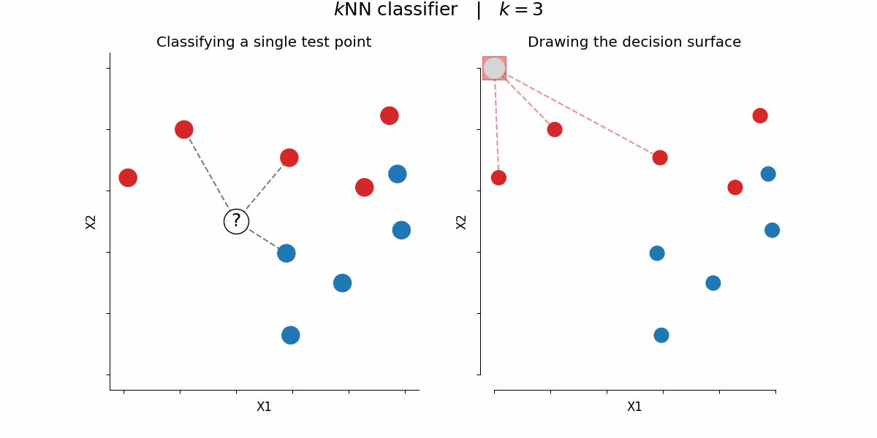
KNN Example
Let’s take K = 3
  What is the label for the majority of closest K = 3 points?
Assign that to the unknown sample (e.g., predict the label!).
Steps
Calculate distance
Find K closest points
Take majority Vote

Slide 15
KNN Advantages
It is extremely easy to implement
It is a non-parametric, lazy learning algorithm
  requires no training prior to making real time predictions.
Since the algorithm requires no training before making predictions, new data can be added seamlessly
  But at a price for down the road… slowing down when predicting for unknown labels.
Much faster “during training” than some other algorithms that you will learn about (e.g., SVM) which learn first from training and then try to generalize (but KNN may be slower in testing, i.e., when put to use).
There are only two parameters required to implement KNN i.e. the value of K and the distance function (e.g. Euclidean, Manhattan…)

Slide 16
KNN Disadvantages
The KNN algorithm doesn't work well with high dimensional data. It suffers from Curse of Dimensionality
  it becomes difficult for the algorithm to calculate distance in each dimension.
The KNN algorithm has a high prediction cost for large datasets.
  The cost of calculating distance between new point and each existing point becomes higher.

Slide 17
Test/train split
Separates data used to fit the model from data used to evaluate the model.
*** A common mistake is repeatedly checking the test set during model development. Once that happens, the test set becomes part of the modeling process and no longer provides an honest final estimate.
Dataset | Purpose
Training set | Used to fit model parameters
Validation set | Used for model selection and hyperparameter tuning
Test set | Used once for final performance evaluation

Slide 18
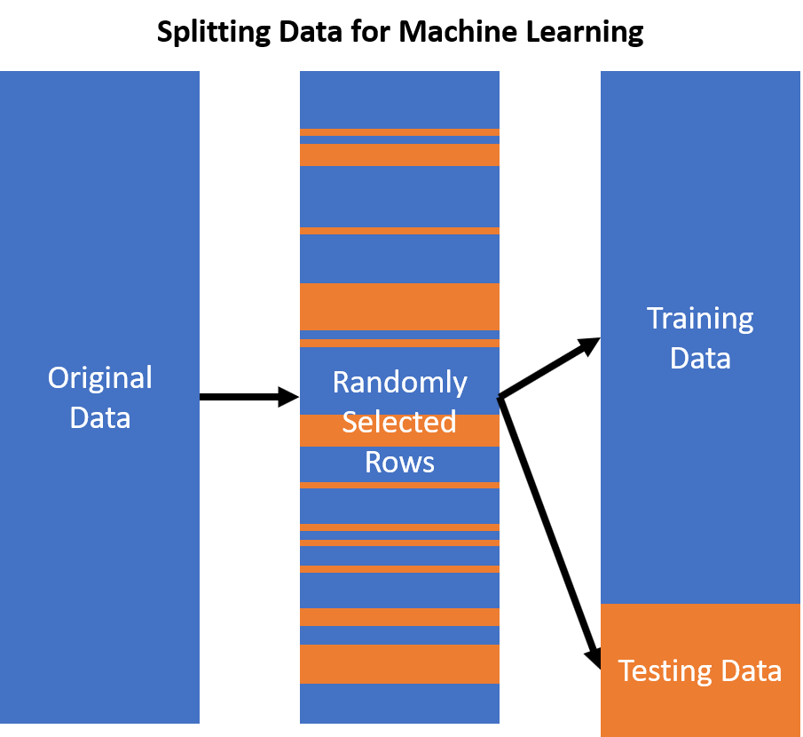
Random split
Randomly assign observations to train and test sets.
Appropriate when:
  Observations are approximately independent.
  Train and test data come from the same population.
  There is no meaningful spatial, temporal, or grouped dependence.
  Often inappropriate in geoscience because nearby or adjacent observations are usually correlated.

Slide 19
Leakage risk with missing data
Imputation must be part of the modeling pipeline and fit only on training data inside each cross-validation fold.
Bad practice:
  Compute global mean using the full dataset.
  Impute missing values.
  Split into train/test.
  This leaks test-set information into training.
Better practice:
  Split data.
  Fit imputer on training data.
  Transform training and test data using training imputer.
  Repeat within each CV fold.

Slide 20
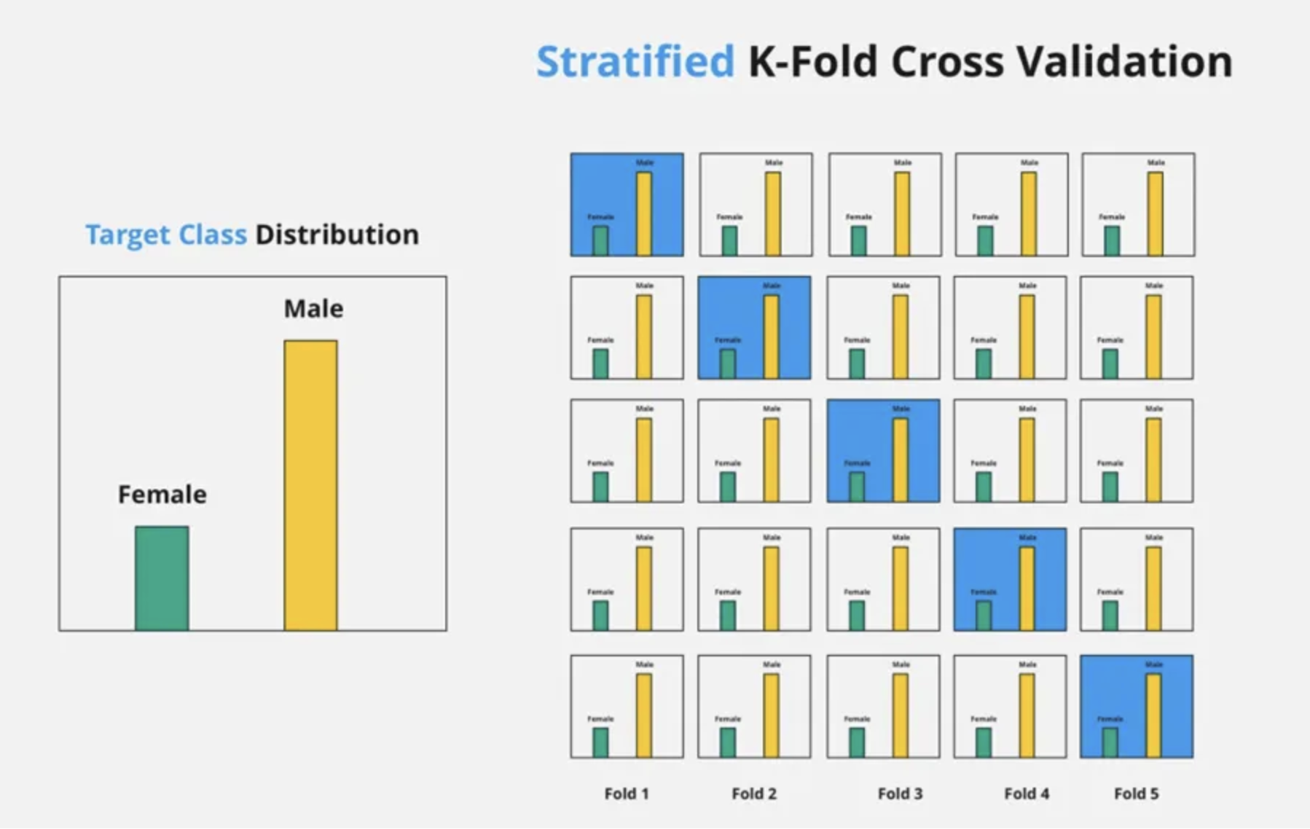
Stratified split
Preserves the distribution of important classes or groups.
Useful for:
  Rare event classification.
  Land-cover classification.
  Landslide presence/absence.
  Flood occurrence.
  Imbalanced datasets.

Slide 21
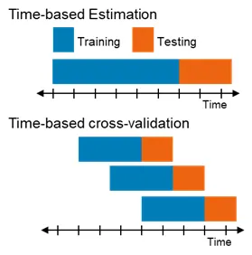
Temporal Split
Train on earlier data and test on later data.
Useful for:
  Forecasting.
  Climate and hydrology.
  Drought prediction.
  Fire risk forecasting.
  Time series gap filling when future performance matters.
Example:
  Train on 2000–2018 data
  Validate on 2019–2020 data
  Test on 2021–2023 data

Slide 22
Spatial Split
Train on some areas and test on held-out areas.
Useful for:
  Spatial mapping.
  Soil prediction.
  Species distribution modeling.
  Mineral prospectivity.
  Remote sensing classification.
  Regional generalization.
Example:
Train on samples from some watersheds, test on entirely different watersheds.

Slide 23
Missing Data
Missing data are common in geoscience but cannot be handled by most machine learning algorithms
Examples:
  Cloud-covered satellite pixels.
  Sensor outages.
  Field samples not collected in inaccessible areas.
  Missing weather station records.
  Gaps in stream gauge data.
  Missing labels for unobserved hazards.
  Satellite retrieval failure over snow, water, or dense vegetation.

Slide 24
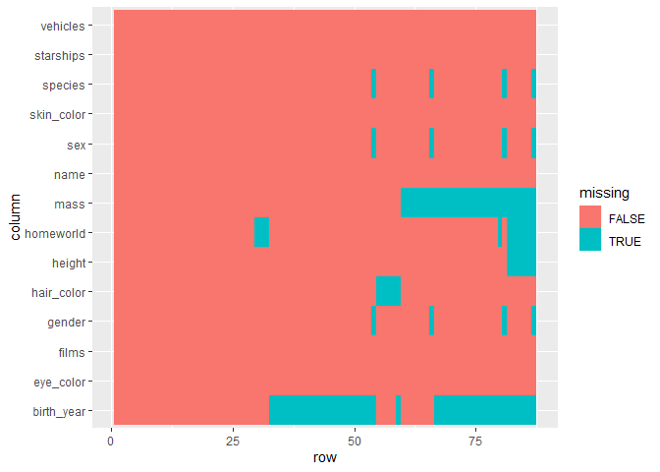
Types of missingness
Missing completely at random
  The probability of missingness is unrelated to the data.
Missing at random
  Missingness depends on observed variables.
Missing not at random
  Missingness depends on unobserved values or the missing value itself.

Slide 25
Strategies for missing data
Deletion
  Remove rows or columns with missing values.
  Simple, but can waste data and be biased
Simple imputation
  Fill missing values with mean, median, mode or constant value.
  Simple, but can underestimates variability and distort relationships.
Group-wise imputation
  Fill missing values using group-specific statistics.
  What are examples of this?

Slide 26
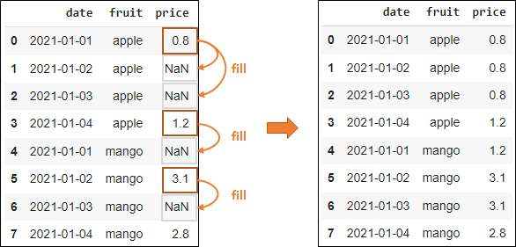
Temporal imputation
Time-series imputation
  Forward fill, Backward fill, Linear interpolation, Rolling-window average
  Warnings:
    Forward fill can be reasonable for slowly varying variables.
    Linear interpolation may be inappropriate across abrupt events.
    Imputation must not use future values if the task is forecasting.

Slide 27
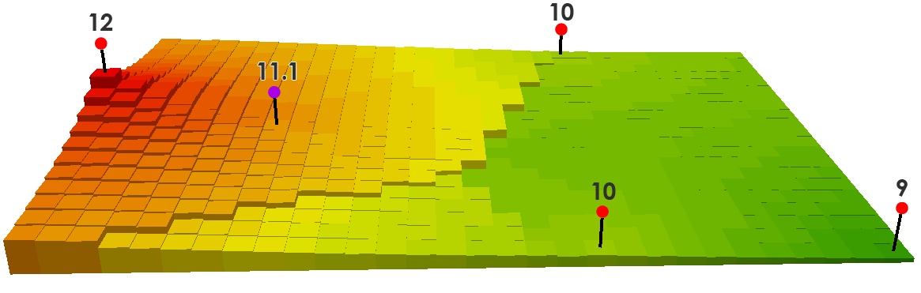
Spatial imputation
Spatial imputation
  Nearest neighbor, Inverse distance weighting, Kriging, Spatial smoothing, Regional mean.
  Warnings:
    Spatial imputation can create leakage if done before train/test splitting.
    Imputation should be fit using training data only when used in ML evaluation.

Slide 28
Group problem
In the class repo, download General/Lectue2…
Work as a group to discuss the code and complete the problem at the end.

